Slide 1
Setting up Slides into RISE
Rui Xue

Slide 2
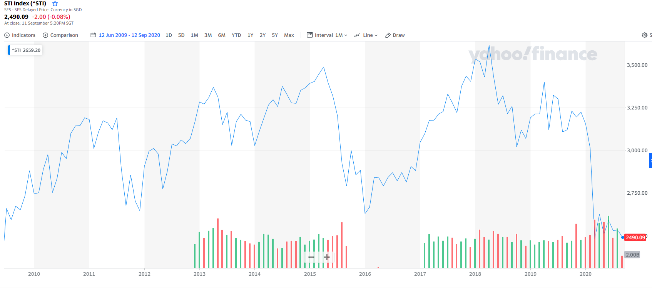
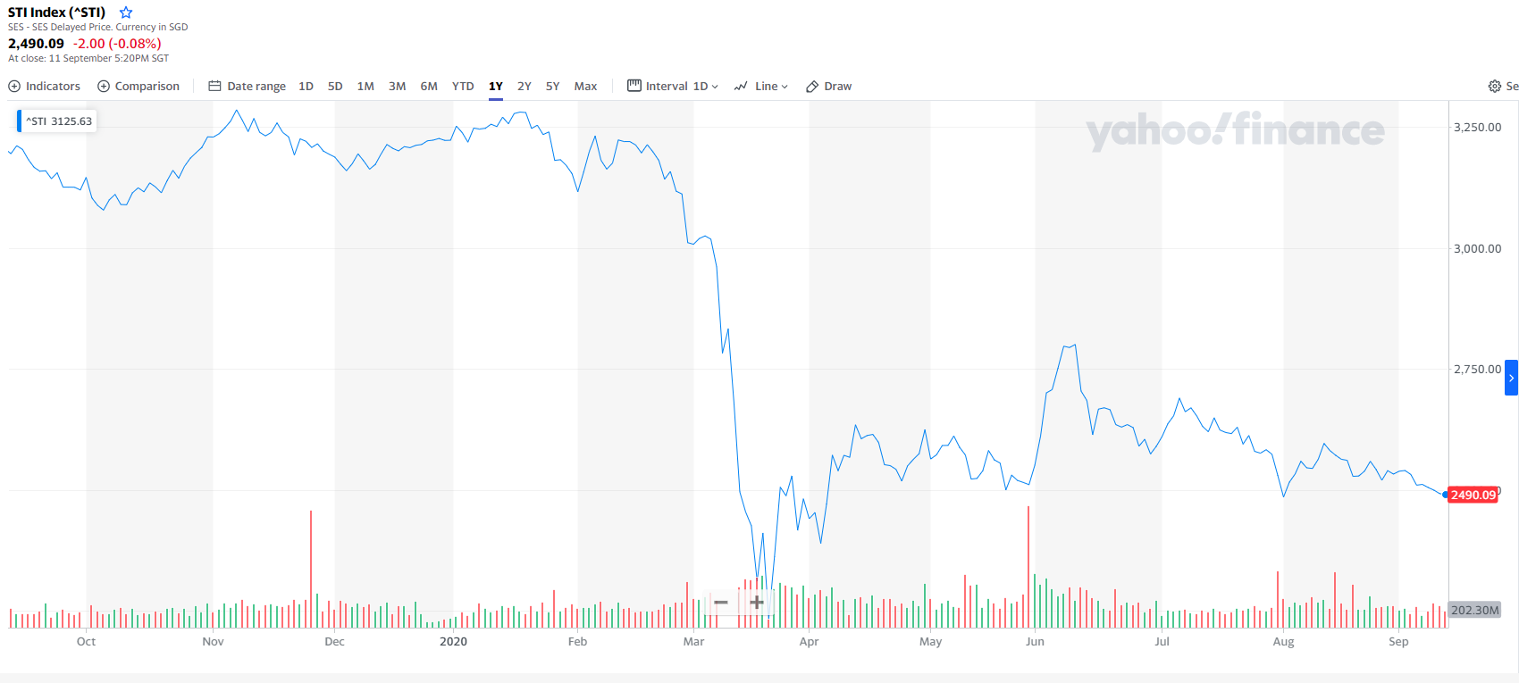
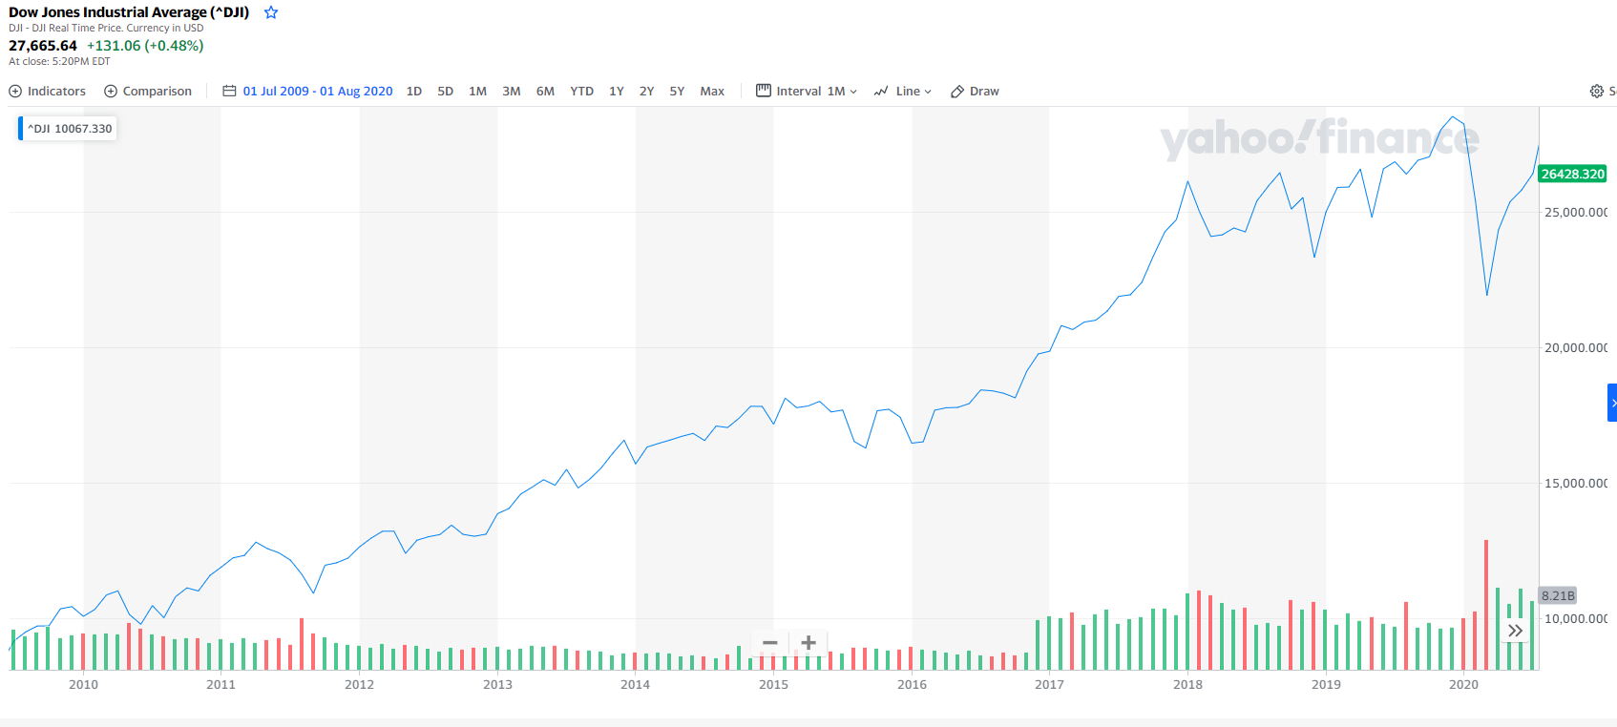
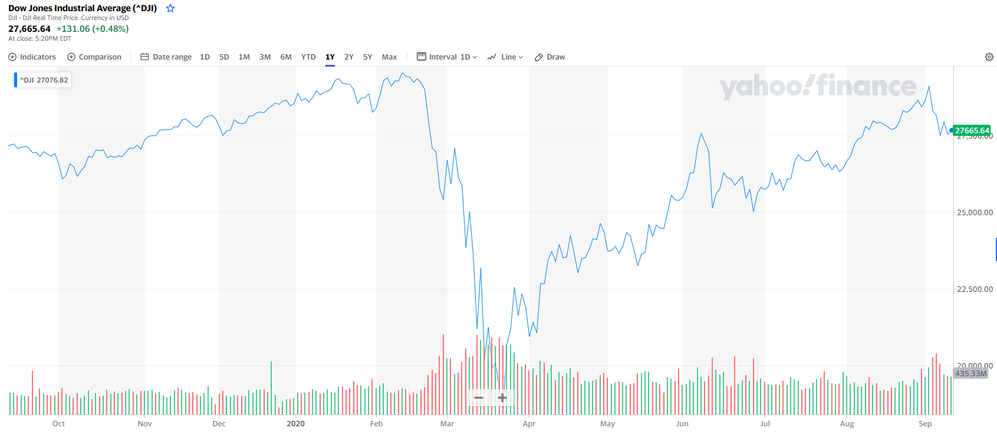
Rui Xue
10-Year chart [STI]
1-Year chart [STI]
Left and right axis showing index value of US and SG.
Overlay of two graphs
or normalized of graphs to overlay.
10-Year chart [US]
1-Year chart [US]

Slide 3
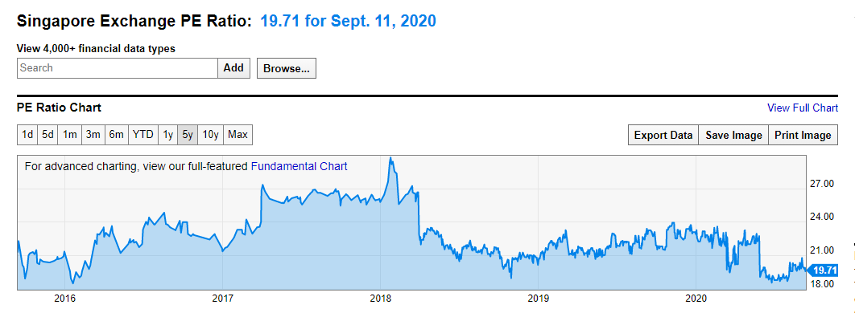
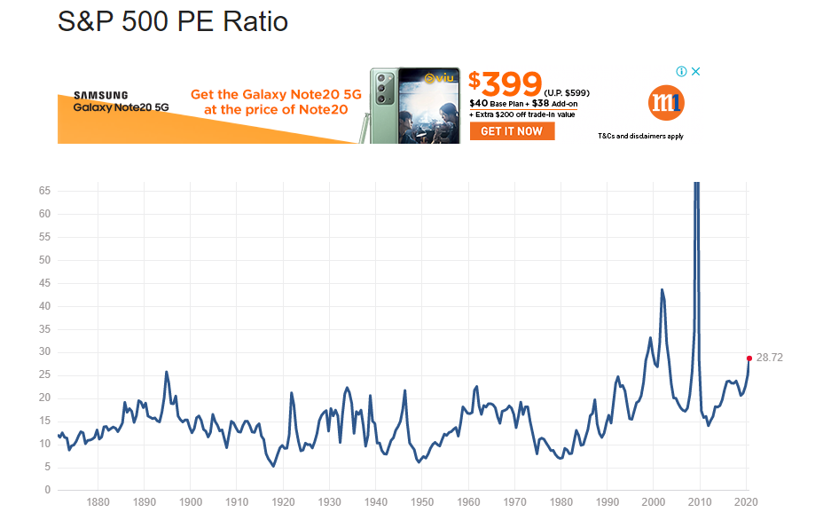
Irna (Rui Xue)
https://ycharts.com/companies/SPXCF/pe_ratio
Plot PE ratio of the SG and US market
Valuation of the market:
US is over-value -> PE ratio chart (2)
STI is under-value -> PE ratio chart (2)
https://franklingu.github.io/data/2018/02/20/using-python-to-analyze-PE-ratio-and-stock-market-performance/

Slide 4
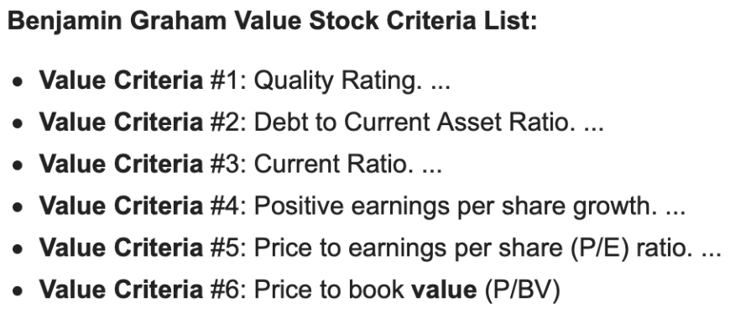
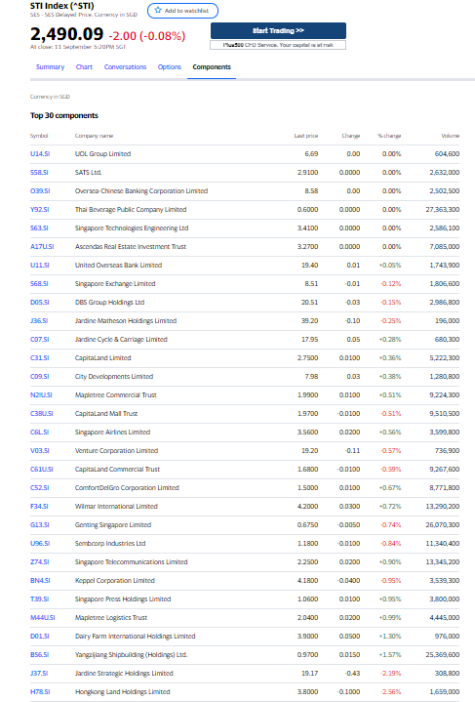
Jordan
graphical plot x2 slides
P/E (Lower better)
Debt to Current Asset(Long term + short term debt/Current Asset <1.1 (Lower better)
Current Ratio (Current Asset/Current Liability) >1.5 (Higher better)
dividendYield (higher better)
Price to Book (lower better)

Slide 5
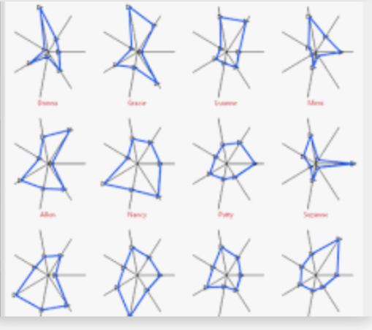
Jordan
Star plot – 2 Slides
P/E (Lower better)
Debt to Current Asset(Long term + short term debt/Current Asset <1.1 (Lower better)
Current Ratio (Current Asset/Current Liability) >1.5 (Higher better)
dividendYield (higher better)
Price to Book (lower better)

Slide 6
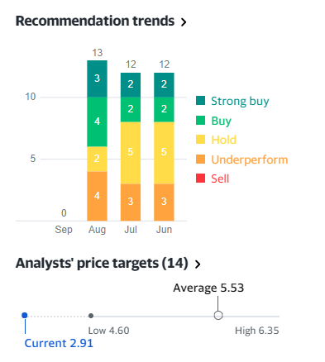
Stock A
Woon Kiat
Aligning with Analyst Recommendation and price target.

Slide 7
Stock B
EQ (Rui Xue)
Economy moat
Companies in the same sector:
Compare by ProfitMargins, (Preferably showing trend), EPS,

Slide 8
Appendix

Slide 9
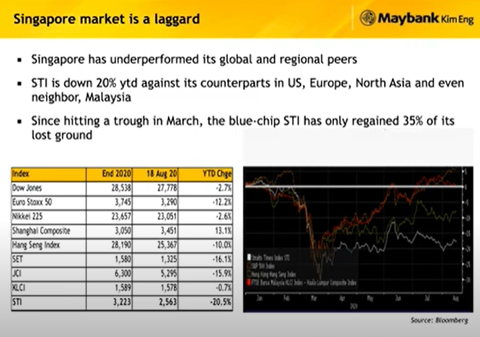

Slide 10
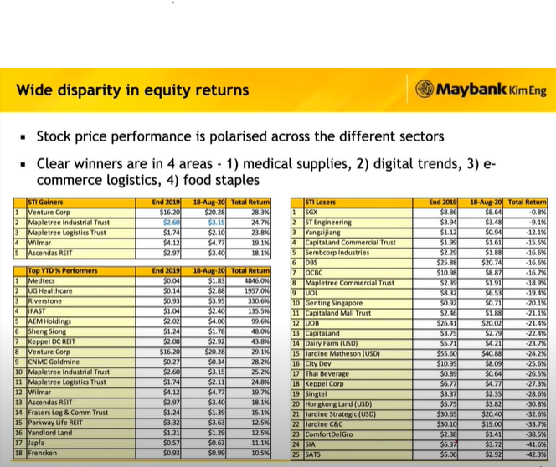

Slide 11
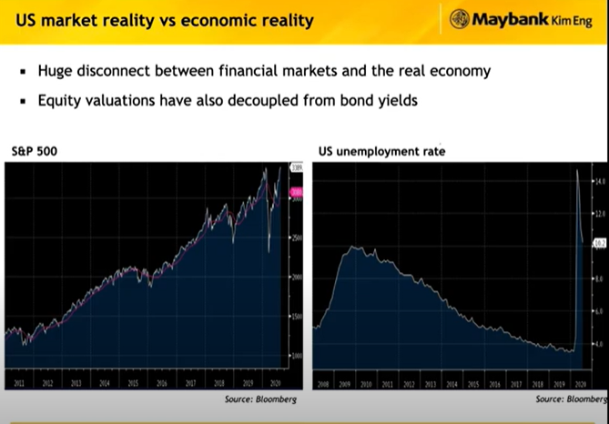

Slide 12
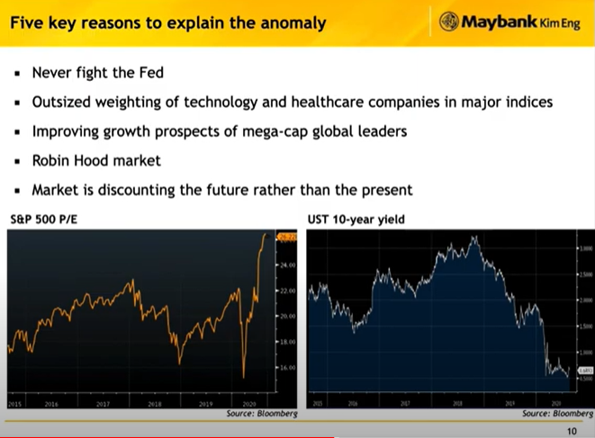

Slide 13
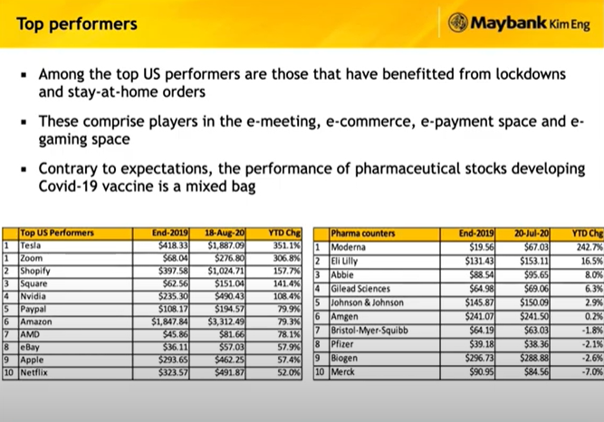

Slide 14
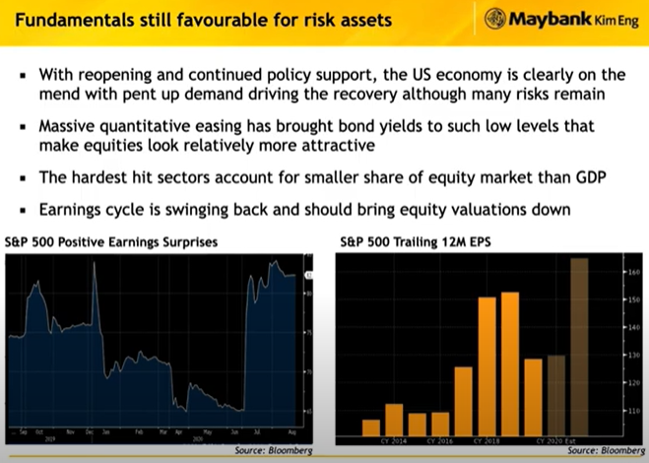

Slide 15
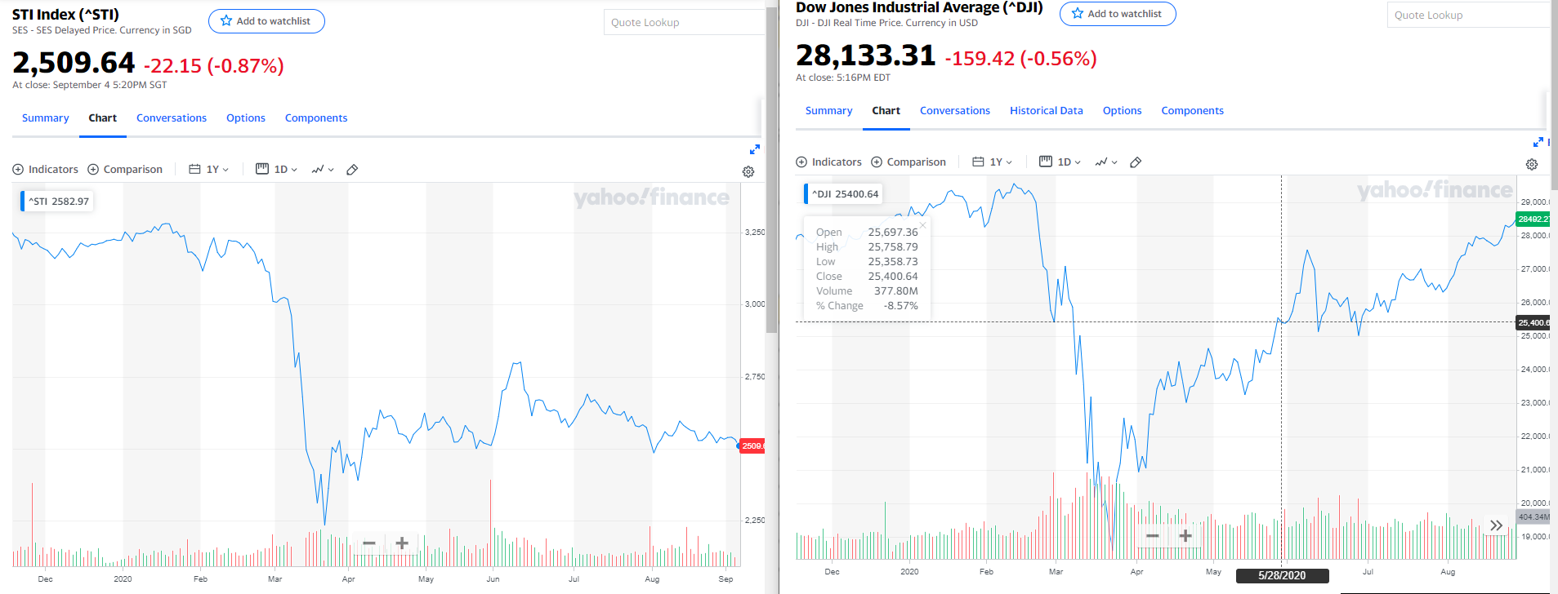
Comparison of markets (STI vs US) (1)
US is over-value -> PE ratio chart (2)
STI is under-value -> PE ratio chart (2)
Opportunity in Singapore (STI) (2)
Zoom in to industry – How? Screening to find this [Research] (3)
Technology
Healthcare
Transport
Pick one stock -> insider transaction and value of the stock (PE, latest earnings) (4-6)
Pick one more? (?)
Recommendation (9)
Technology research (How to use markdown, visualisation?)

